Slide 1
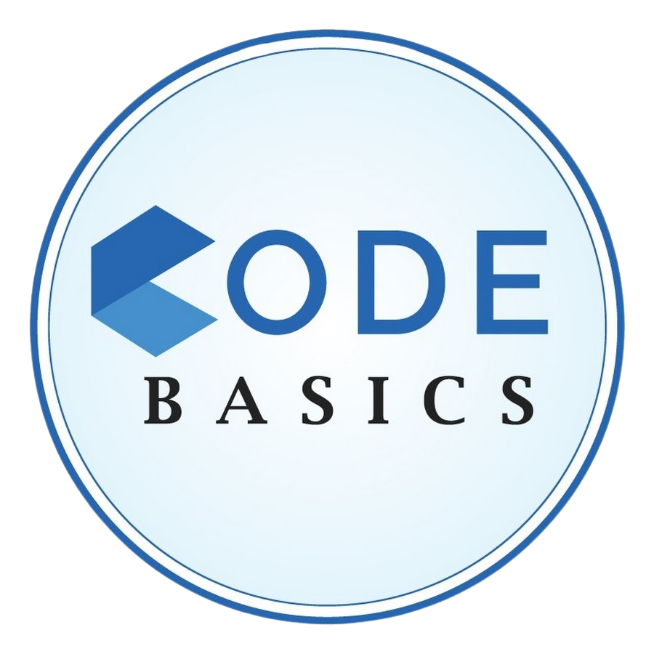

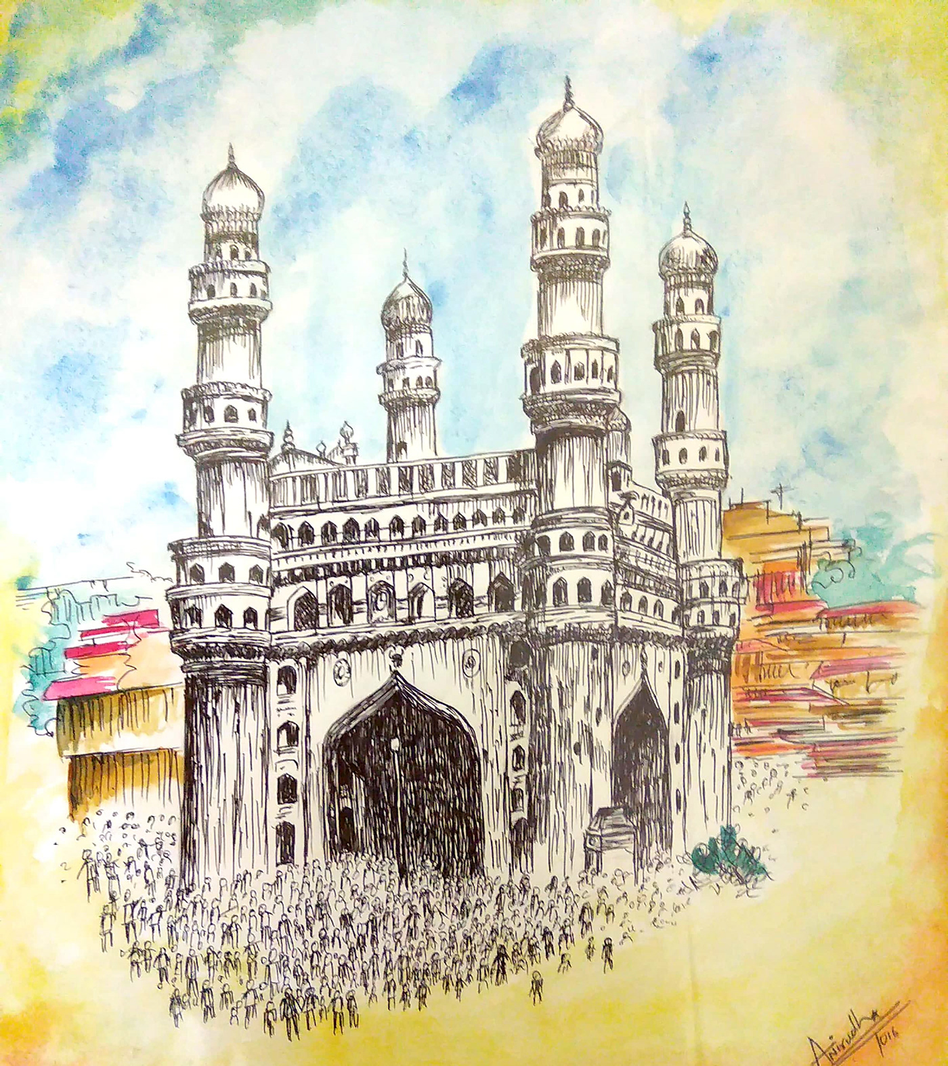
Provide Insights For Telangana Tourism Department
- By Arnav Patnaik

Slide 2
Agenda
01
02
03
Objective
Overview
Data
04
05
Trends & Insights
Opportunities & Challenges

Slide 3

Objective
The objective of this presentation would be to present my findings and insights from my analysis of Telangana's tourism data and provide data-informed recommendations to the Telangana government on how to improve their revenue and administrative operations in the tourism sector.

Slide 4
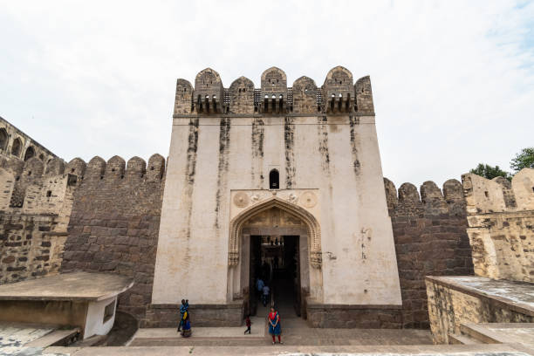
Overview
Telangana is a state in southern India that has a rich cultural heritage and diverse natural landscapes.
The state's tourism industry has been growing steadily over the years, thanks to its many historical monuments, religious sites, natural attractions, and vibrant urban centres.

Slide 5
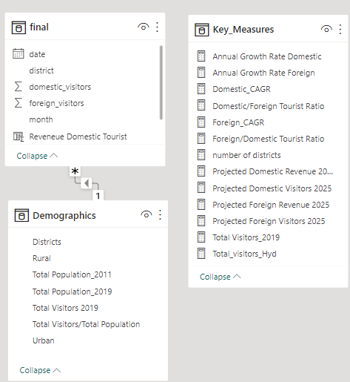
Data
I utilized data on domestic and foreign visitors for the years 2016 to 2019 to analyze tourism trends in Telangana.
I merged the data for domestic and foreign visitors from these years
I incorporated a demographics dataset that provided population data for Telangana in the year 2011.

Slide 6
Trends & Insights

Slide 7
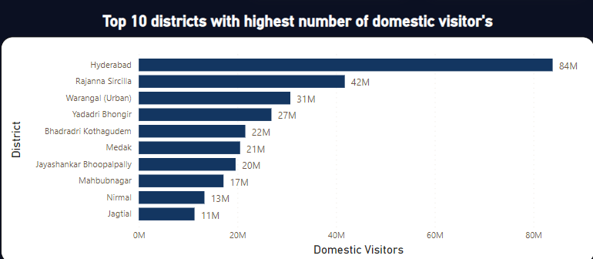
Exploring the Domestic Tourism Landscape in Telangana
Hyderabad is home to several historical monuments, is the IT hub of India and has one of the largest film industries which is the Telugu film industry.
Rajanna Sircilla is known for its textile industry.
Warangal offers several historical and architectural marvels.

Slide 8
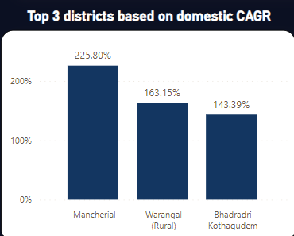
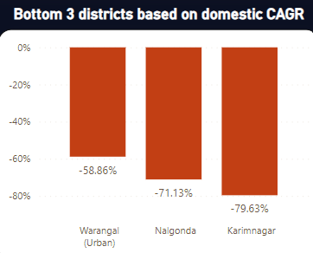
Mancherial has strong contributions from coal mining and diverse industrial development, along with a favourable climate for agriculture and significant infrastructure
Warangal (urban) has a low CAGR due to limited industrial growth, low agriculture output, inadequate infrastructure, and low tourist footfall.
Karimnagar has a low CAGR due to heavy dependence on agriculture, limited industrial development, inadequate infrastructure facilities, political instability, and limited tourism potential.

Slide 9
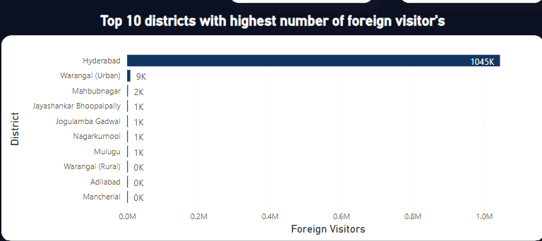
Understanding the Trends and Insights of Foreign Tourists in Telangana
Hyderabad is a popular destination for foreign visitors due to its rich history, culture, and being a hub for business and IT companies.
Warangal offers several historical and architectural marvels.
Mahbubnagar has several tourist attractions, such as the Koilsagar Dam, the Kollapur Palace, and the Alampur Jogulamba Temple.

Slide 10
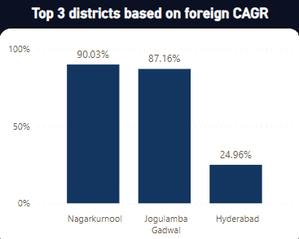
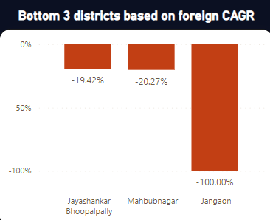
Nagarkurnool attracts foreign tourists with its natural beauty, adventure tourism, and wildlife sanctuaries.
Jogulamba Gadwal's historical and cultural sites, handloom products, and proximity to Hyderabad make it a popular destination for foreign tourists.
Jangaon has limited tourist attractions, inadequate infrastructure and marketing, a lack of accommodation facilities and basic amenities, and inadequate transport facilities have resulted in a low CAGR in tourism.

Slide 11
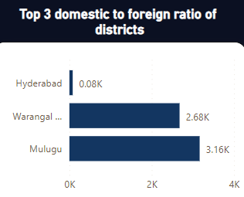
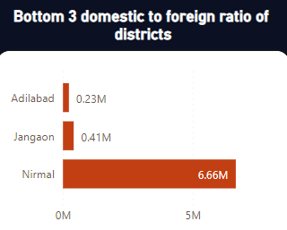
Comparison Indicators
Hyderabad is a major economic and cultural hub in South India, attracting a large number of domestic and foreign tourists to its historical landmarks and business centers.
Mulugu is a district with a high ratio of domestic tourists to foreign tourists, primarily due to its popularity as a weekend getaway spot for locals and the presence of famous Hindu temples.
Nirmal has the least Domestic to foreign ratio.

Slide 12
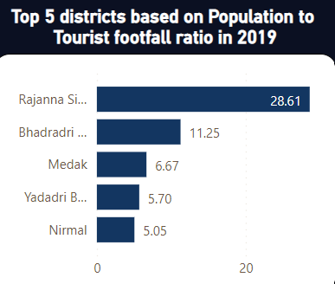
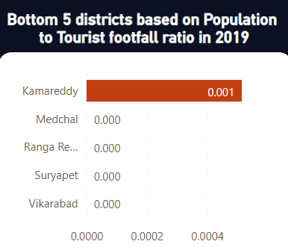
Comparison Indicators
Rajanna Sircilla has high population to tourist footfall due to the handloom industry, Kargil Park, and the historical Sircilla Fort, and high population.
Bhadradri Kothagudem has high tourist footfall due to Kothagudem Thermal Power Station and Kinnerasani Wildlife Sanctuary, and its high population.
Kamareddy, Medchal, Ranga Reddy, Suryapet, and Vikarabad have a low population-to-tourist footfall ratio, which can be attributed to their limited tourist attractions, inadequate infrastructure, and basic amenities.

Slide 13
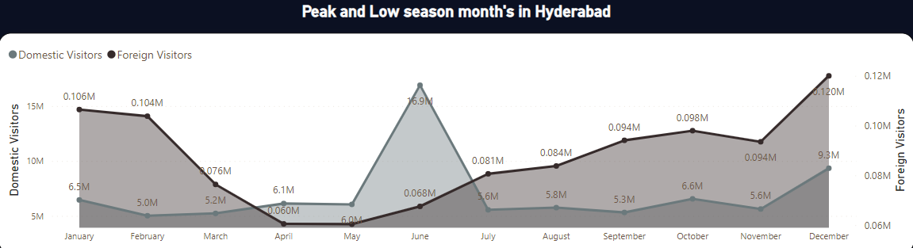
Analyzing Hyderabad
Reasons for the peak months of foreign visitors in Hyderabad (December, January, and February) could be the pleasant winter weather, lower airfare and hotel rates, and popular events such as the Hyderabad Literary Festival and International Kite Festival.
February and March are low-season months for domestic visitors in Hyderabad due to hot and dry weather, while September is low due to monsoon season and school schedules.

Slide 14
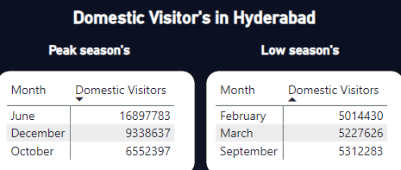
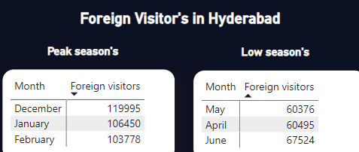
Analyzing Hyderabad
Foreign visitors prefer to visit Hyderabad during December, January, and February due to pleasant weather, cultural events and festivals, and the holiday season in many countries.
May, April, and June are considered the low season for foreign visitors to Hyderabad due to hot and humid weather and coinciding with summer holidays in many countries, leading to a decrease in foreign tourist footfall.

Slide 15
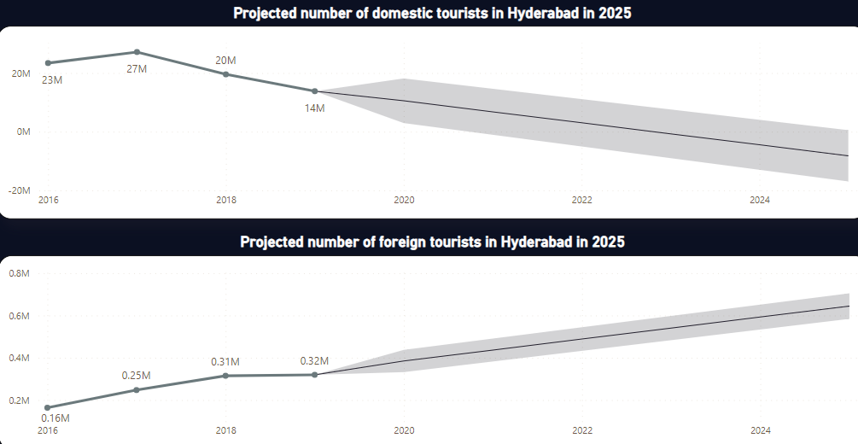
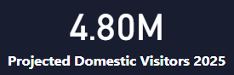

The projected number of domestic tourists in Hyderabad happens to be 4.80 million in the year 2025 with a domestic annual growth rate of -4.44%
The projected number of foreign tourists in Hyderabad happens to be 1.22 million in the year 2025 with a foreign annual growth rate of 24.74%

Slide 16
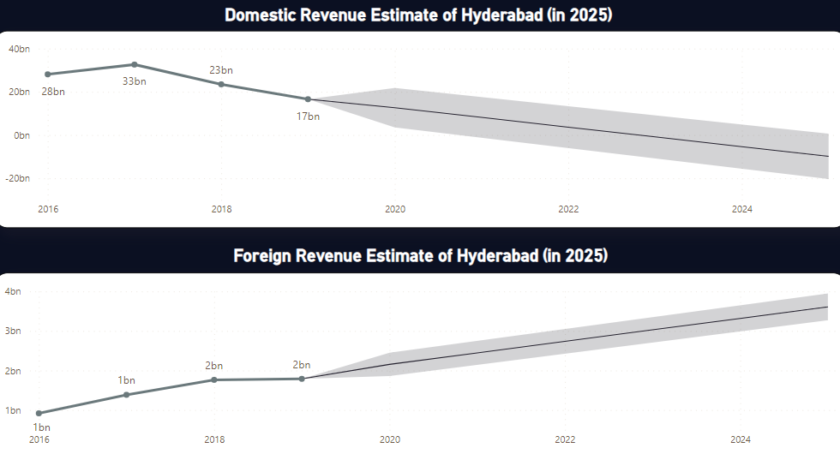
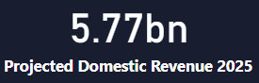
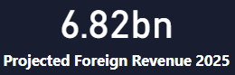
The projected domestic revenue that will be generated for tourism in Hyderabad will be 5.77 billion for the year 2025.
The projected foreign revenue that will be generated for tourism in Hyderabad will be 6.82 billion for the year 2025.

Slide 17
Opportunities & Challenges

Slide 18
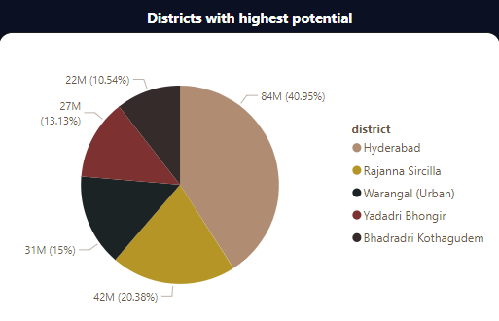
Districts with highest potential
Hyderabad is a popular destination due to its historical monuments, culture, and IT industry.
Rajanna Sircilla district is renowned for its handloom industry and Kargil Park, which attracts domestic tourists seeking an authentic cultural experience.
Warangal (Urban) district is home to the iconic Warangal Fort and Thousand Pillar Temple, which attract tourists interested in exploring the region's heritage.
Yadadri Bhongir district is a sought-after destination for spiritual experiences and scenic landscapes.
Bhadradri Kothagudem district is a popular tourist destination due to its blend of industrial and natural attractions.

Slide 19
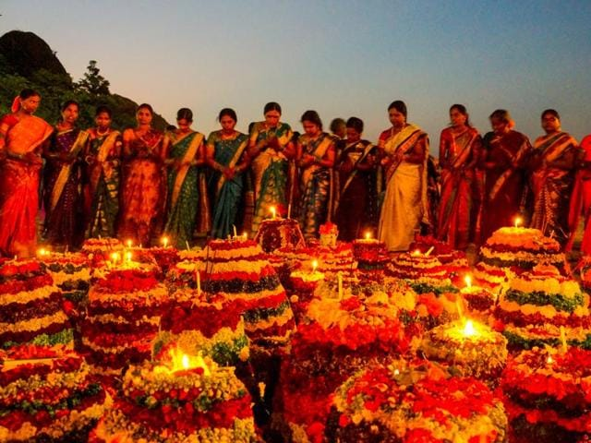
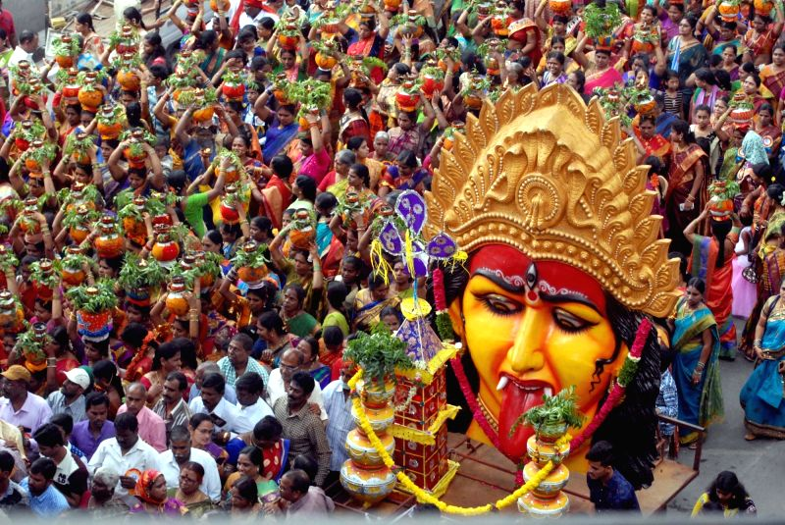
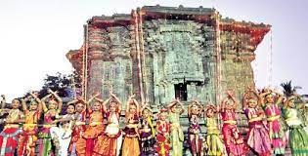
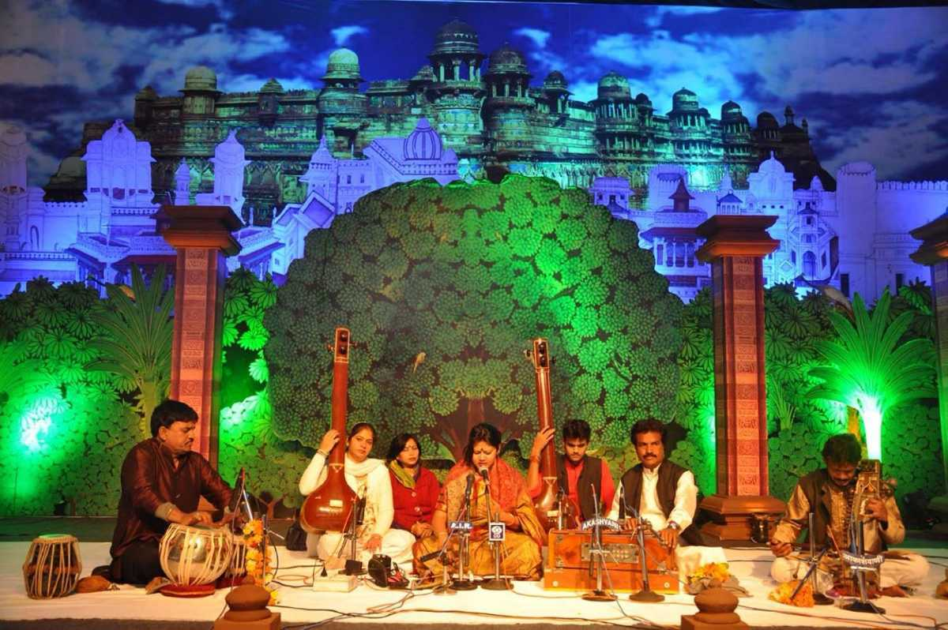
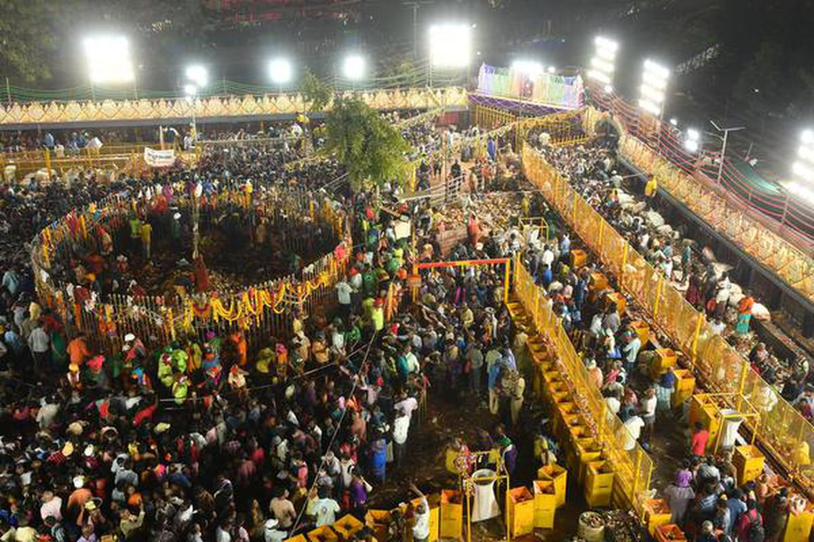
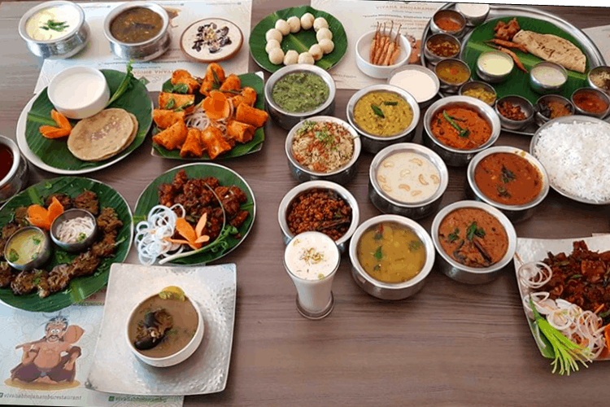
Events that can be organised
Bathukamma Festival in Hyderabad during September or October.
Deccan Festival in Hyderabad during February.
Bonalu Festival in Warangal in July or August.
Sammakka Saralamma Jatara in Medaram and Mulugu in January or February.
Kakatiya Festival in Warangal during December.
Telangana Food and Art Festival in Nizamabad during April.

Slide 20
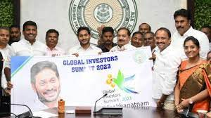
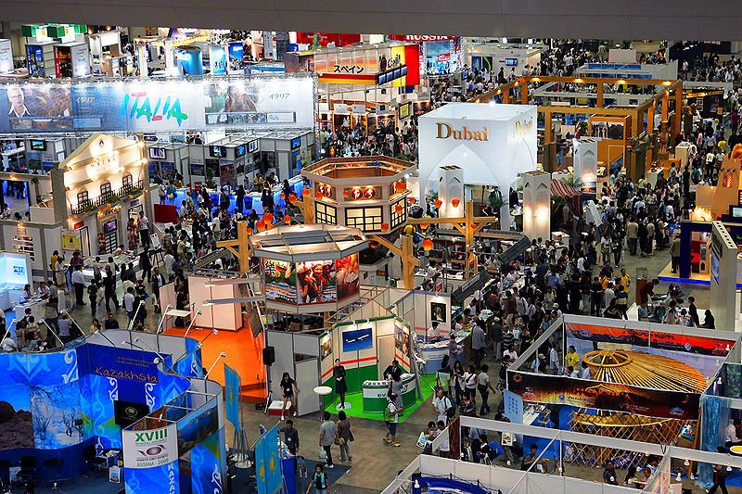
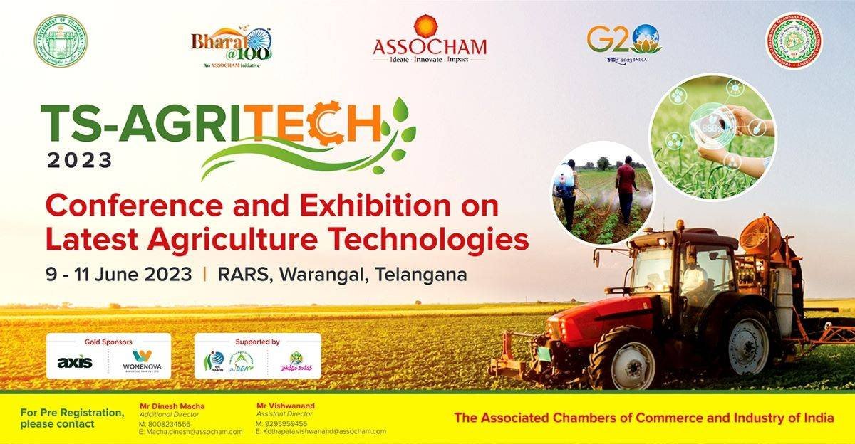
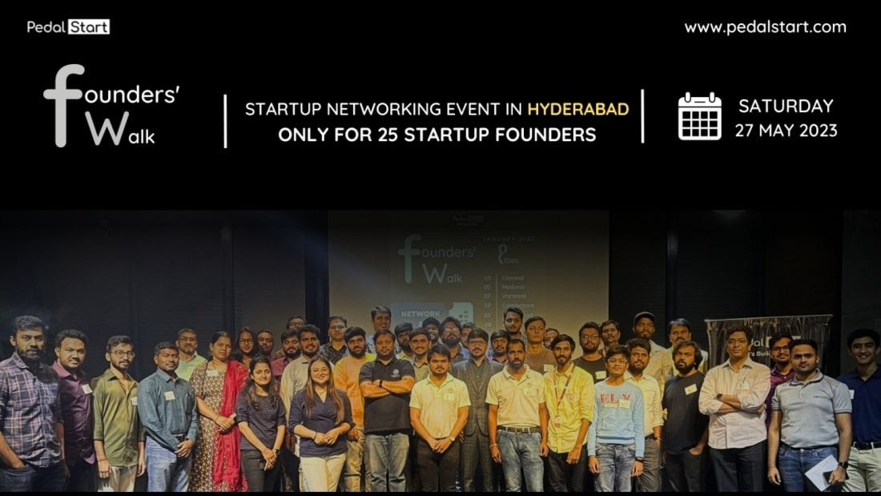
Telangana Global Investors Summit in Hyderabad in September or October.
Telangana Agri-Tech Expo in Karimnagar, Warangal and Hyderabad in February, April or June.
Telangana Trade and Export Fair in Nalgonda in April
Telangana Business Networking Gala in Medak and Hyderabad in August.

Slide 21

Dubai Tourism Model
World-class infrastructure, including modern airports, transportation networks, luxury hotels, shopping malls, and entertainment facilities, providing convenience and comfort to tourists.
Diverse tourism offerings, catering to different interests and preferences, ranging from luxury shopping and dining to desert safaris and water sports.
Duty-free shopping experience in numerous malls and markets, offering a wide selection of international brands and products.
Strong focus on safety and security, with low crime rates, efficient law enforcement, and strict regulations ensuring the well-being of tourists.
Effective marketing and promotion strategies to attract visitors.
Dubai is a global transit hub with direct flights from various destinations, making it convenient for tourists to explore.

Slide 22
Strategy
1
2
3
Build Infrastructure
Develop and maintain iconic landmarks and attractions
Diverse tourism offerings
5
4
Enhancing Safety & Security
Marketing and Promotion

Slide 23
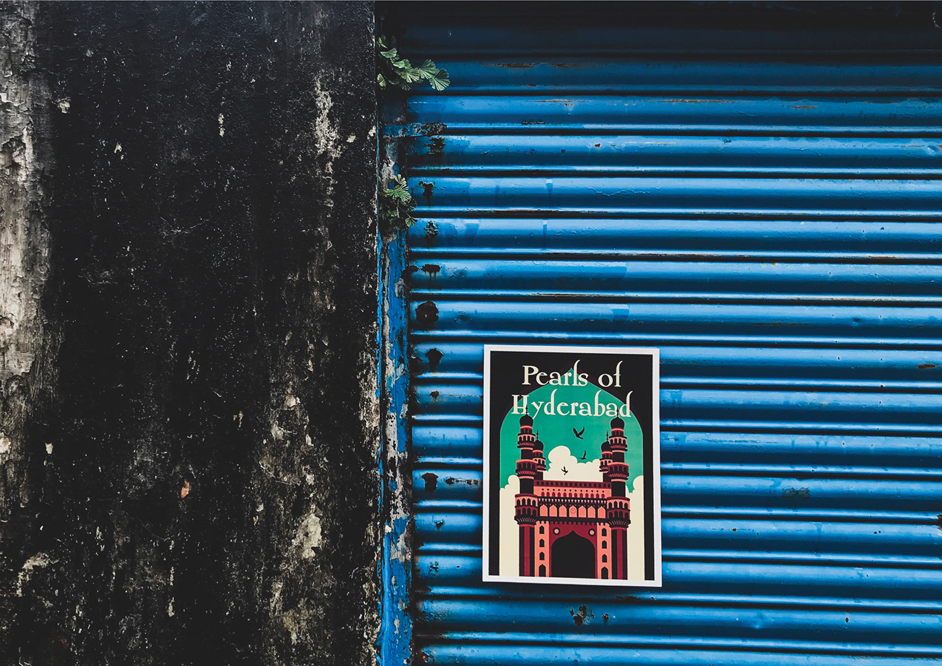
Thank you!
Do you have any questions?
patnaikarnav3@gmail.com

